Slide 1

Final Year Project
In-Cabin Passenger Detection using millimeter-Wave Radar
Team Members: Raiha Raees, Areeba Mehboob, Syeda Zayra Batool
Advisor: Dr. Nosherwan Shoaib, Dr. Hammad M. Cheema
FYDP Final Defence EE SEECS NUST Main Campus
1

Slide 2
Introduction
Problem Statement
Literature review
Objectives
Methodology
Implementation
Results
Demo Video
Conclusion
Table of Content
FYDP Final Defence EE SEECS NUST Main Campus
2

Slide 3
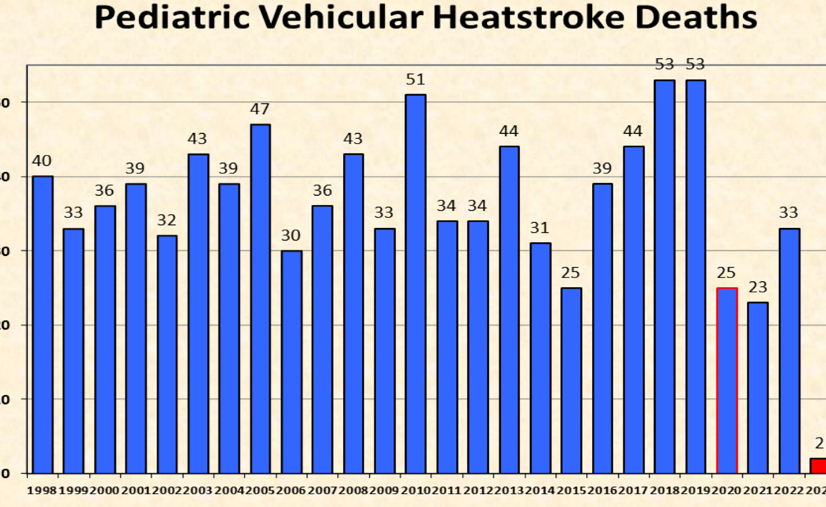
Problem Statement
An examination of media reports about the 938 pediatric vehicular heatstroke deaths for a 25-year period (1998 through 2022) shows the following circumstances:
- 52.61% - Forgotten by caregiver (496 children)
- 25.29% - Gained Access on their own (237)
- 20.28% - Knowingly left by caregiver (190)
- 1.81% - Unknown (17)
More than half of the deaths (54%) are children under 2 years of age.
https://noheatstroke.org/original/index.html
FYDP Final Defence EE SEECS NUST Main Campus
3

Slide 4

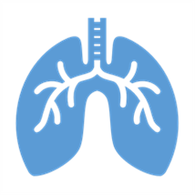

SafeAuto
SafeAuto is a new IoMT device for accurate non-contact breathing rate measurement to ensure child safety in a vehicle.
The estimated breathing rates are communicated to the user (parent/guardian) over wifi.
This device uses a 60 GHz short range pulsed radar.
FYDP Final Defence EE SEECS NUST Main Campus
4

Slide 5
Literature Review
Ref. # | Paper | Radar | Frequency | Subject Distance | %Error (Breathing Rate) | Methodology
[2] | (S. Wang, 2015) | FMCW | 80 GHz | 1m | 6.89% | FFT
[3] | (M. Alizadeh, 2019) | FMCW | 77 GHz | 1.7m | 6% | FFT
[4] | (Zhicheng Yang, 2016) | CW | 60 GHz | 1m | 2% | FFT
FYDP Final Defence EE SEECS NUST Main Campus
5

Slide 6
Objectives
This project aims to design an efficient system with low false-positive and false-negative rates having the objectives:
To perform detection of any in-Cabin passengers.
To distinguish between children and adults.
To alert the owner or the guardian if a child is accidentally left behind in the car so any accidents can be prevented.
To promote child passengers’ health and safety, aiming towards achieving SDG 3.
FYDP Final Defence EE SEECS NUST Main Campus
6

Slide 7
Block Diagram
1
2
3
4
5
6
DATA ACQUISITION
PREPROCESSING
FEATURE EXTRACTION
FEATURE SELECTION
CLASSIFICATION
NOTIFICATION
Reshaping of data from H5 file and extracting inphase and quadrature components
A message will be sent to the caregiver of the child that your child is locked in car.
Storing Breathing Data from xm112 for preprocessing
Using filters to extract frequency components.
Calculating Breaths Per Minute to perform classification.
Data passes through ML classifier for detection
FYDP Final Defence EE SEECS NUST Main Campus
7

Slide 8
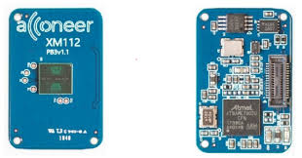
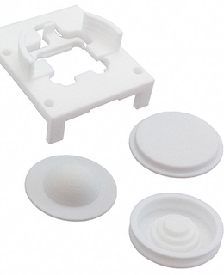
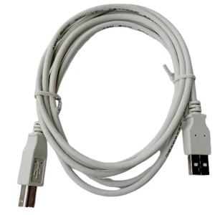



Hardware & Tools
XM112 radar module
Lens
Usb cable
Visual studio
Colab
FYDP Final Defence EE SEECS NUST Main Campus
8

Slide 9
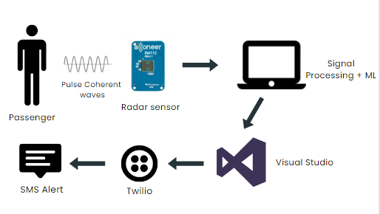
Methodology
Our prototype first receives pulse coherent waves reflected back from the passenger.
These signals are then processed to compute breathing rate.
The breathing rate is classified as as adult’s or a child’s using ML model.
Visual Studio is utilized for signal processing, while Twilio is integrated with Visual Studio to facilitate user notifications.
FYDP Final Defence EE SEECS NUST Main Campus
9

Slide 10
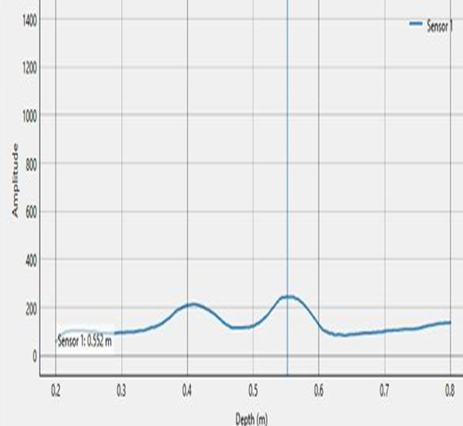
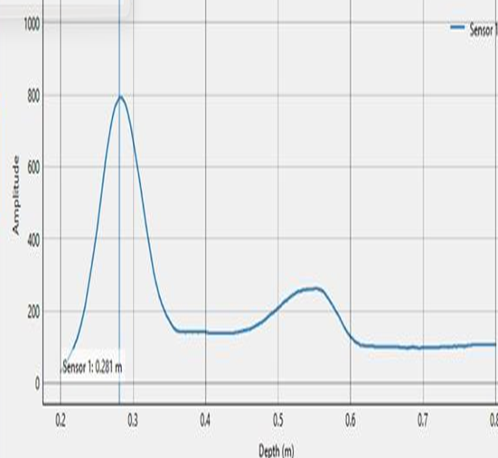
Implementation:
Data Acquisition (Presence Detection)
No object
With object
FYDP Final Defence EE SEECS NUST Main Campus
10

Slide 11
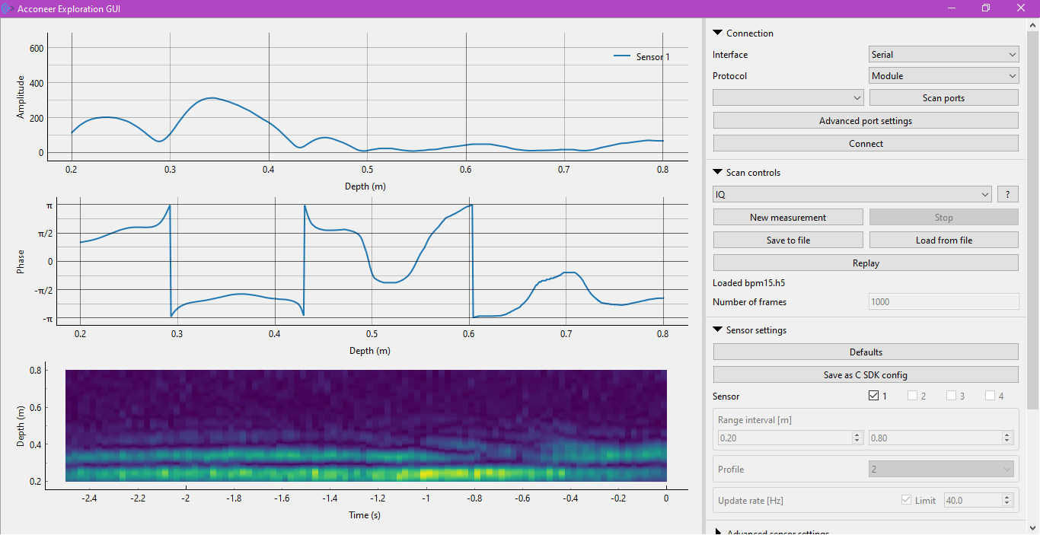
Data Acquisition (IQ)
Amplitude and Phase of Radar Data
FYDP Final Defence EE SEECS NUST Main Campus
11

Slide 12
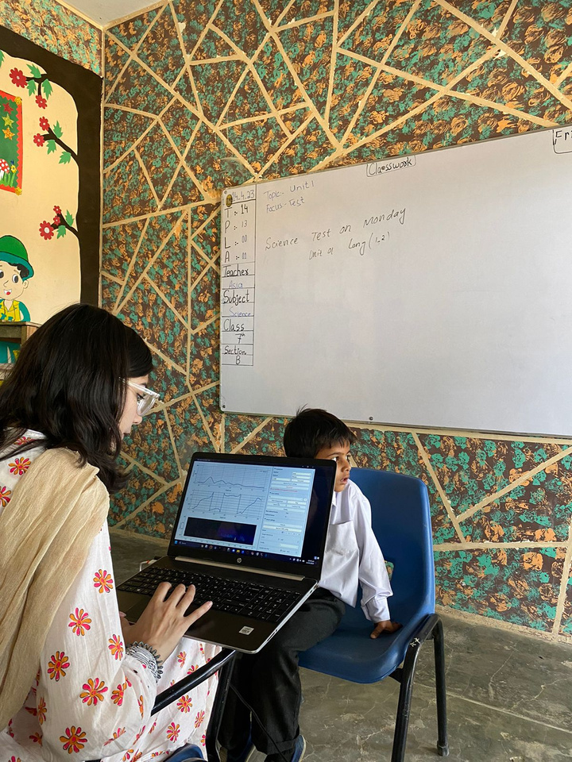
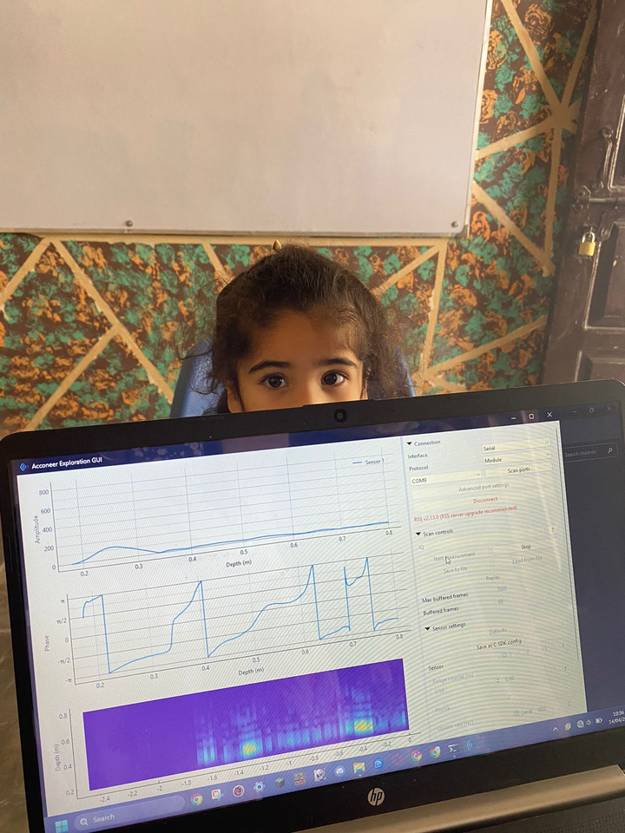
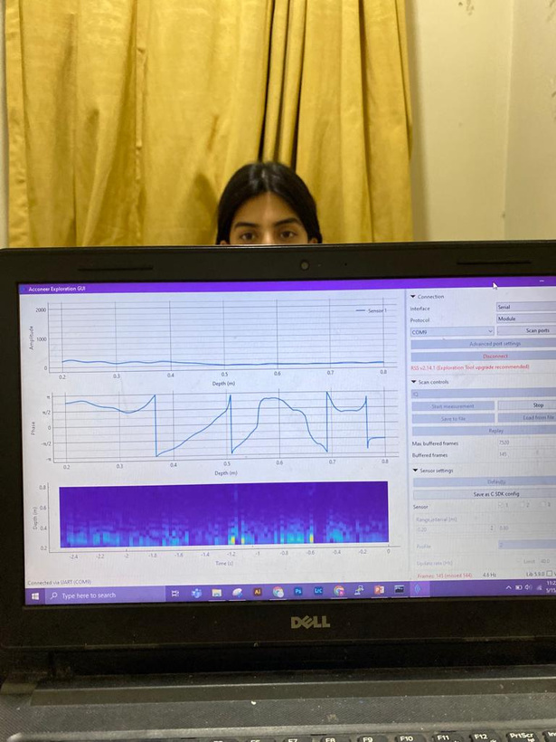
Implementation:
Data Collection at Fazilia Public School and NUST
FYDP Final Defence EE SEECS NUST Main Campus
12

Slide 13
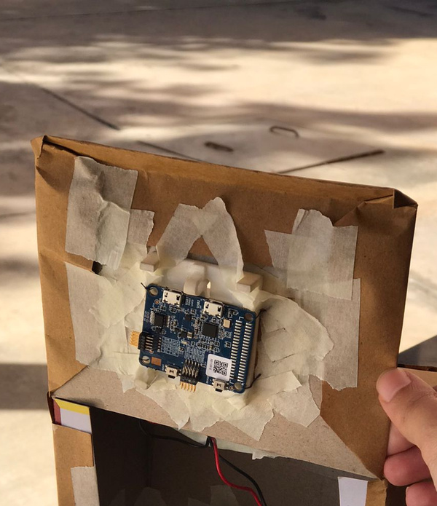
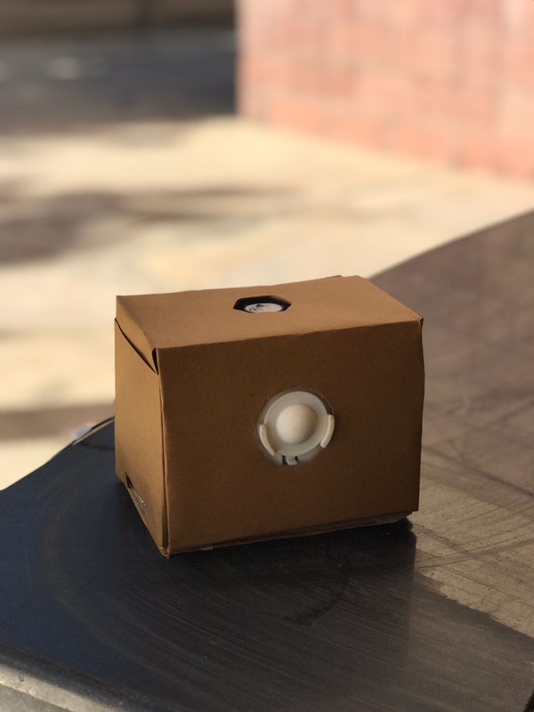
Hardware Implementation
XM112
radar module
Lens
FYDP Final Defence EE SEECS NUST Main Campus
13

Slide 14

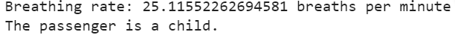
Results - Signal Processing
We initially processed the incoming signal into breathing rate using Google Colab.
The results of which are shown as:
For verification purposes, we manually counted the beathing rate of six subjects and the value calculated using radar was shown to give 95.48% accuracy.
Results - Machine Learning
After putting the calculated respiration rate through the trained KNN classifier, Colab gives us the results in the following form:
FYDP Final Defence EE SEECS NUST Main Campus
14

Slide 15
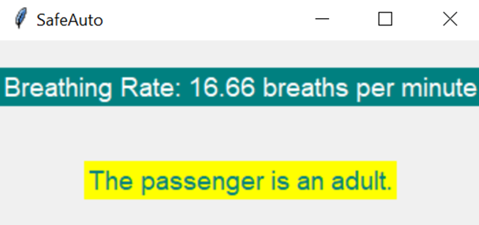
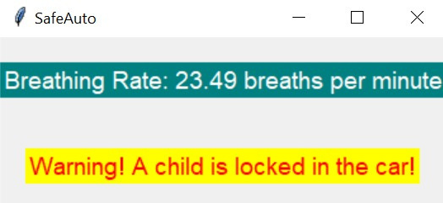

GUI
Here is the graphical user interface for SafeAuto:
Text Alert
Twilio is used via visual studio for text alert.
FYDP Final Defence EE SEECS NUST Main Campus
15

Slide 16
Percentage Accuracy
Subject | Breathing rate from radar | Breathing rate from manual counting | Percentage accuracy
1 | 20.68 20.46 | 20 19 | 96.6 92.315
2 | 19.85 18.97 | 19 19 | 95.526 99.842
3 | 16.21 18.23 | 17 18 | 95.352 98.72
Subject | Breathing rate from radar | Breathing rate from manual counting | Percentage accuracy
4 | 14.57 20.21 | 14 21 | 95.928 96.238
5 | 20.67 16.51 | 19 17 | 91.210 97.11
6 | 17.48 15.39 | 16 16 | 90.750 96.188
FYDP Final Defence EE SEECS NUST Main Campus
16

Slide 17
Demonstration Pictures and Video
Link to the Demo Video:
Click here
FYDP Final Defence EE SEECS NUST Main Campus
17

Slide 18
FYDP Deliverables Upload Status (PMS)
Sr No. | FYDP Deliverables | Status
1 | Final Report | Yes
2 | Final Presentation slides | Yes
3 | Poster (A1 size) | Yes
4 | Plagiarism report | Yes
5 | Demo Video | Yes
FYDP Final Defence EE SEECS NUST Main Campus
18

Slide 19
References
[1] Fact Sheet - Heatstroke Deaths of Children in Vehicles. (n.d.-b). https://noheatstroke.org/original/index.html
[2] Wang, S., Pohl, A., Jaeschke, T., Czaplik, M., Köny, M., Leonhardt, S., & Pohl, N. (2015). A novel ultra-wideband 80 GHz FMCW radar system for contactless monitoring of vital signs. https://doi.org/10.1109/embc.2015.7319509
[3] Alizadeh, M., Shaker, G., De Almeida, J. C. M., Morita, P. P., & Safavi-Naeini, S. (2019). Remote Monitoring of Human Vital Signs Using mm-Wave FMCW Radar. IEEE Access, 7, 54958–54968. https://doi.org/10.1109/access.2019.2912956
[4] Yang, Z., Pathak, P. H., Zeng, Y., Liran, X., & Mohapatra, P. (2016). Monitoring vital signs using millimeter wave. https://doi.org/10.1145/2942358.2942381
FYDP Final Defence EE SEECS NUST Main Campus
19

Slide 20
Thank You!
FYDP Final Defence EE SEECS NUST Main Campus
20

